Slide 1
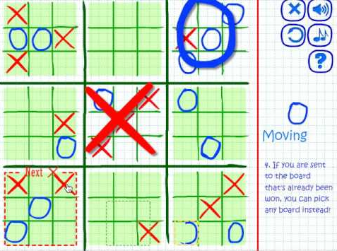
P3 Assigned:
MCTS for Ultimate Tic Tac Toe

Slide 2
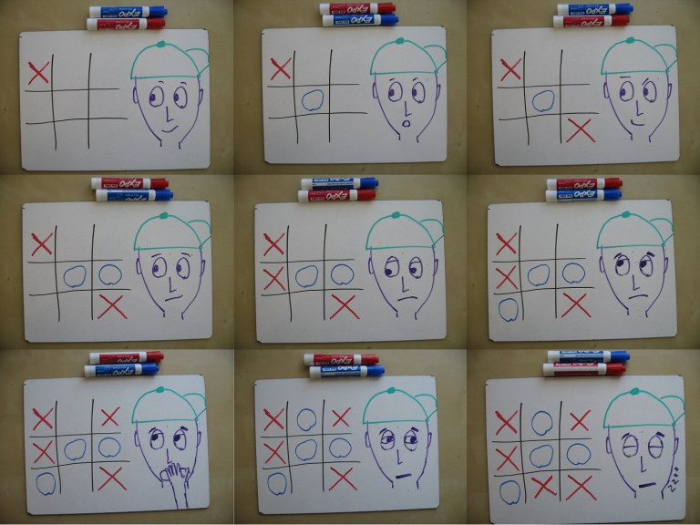
Usual Tic Tac Toe

Slide 3
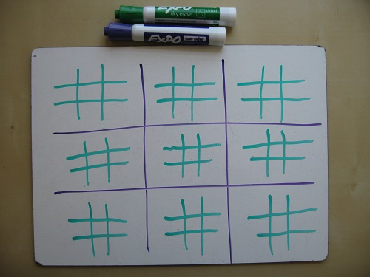
Ultimate Tic Tac Toe

Slide 4
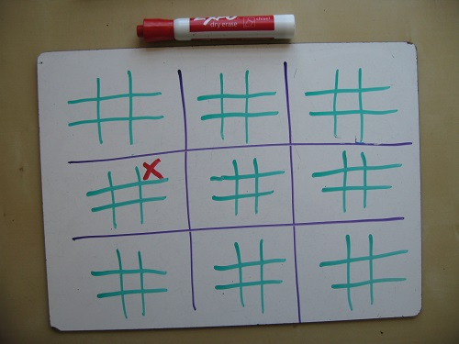
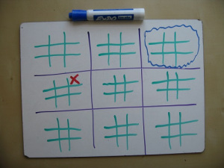
How to move

Slide 5
Implement MCTS for a simple-ish game
(Your code won’t have much game-specific stuff in it)
Implement a variation of MCTS
(E.g., from today’s lecture; suggestions in the writeup)
Evaluate differences in win rates between your bots

Slide 6
P3: Key modules
p3_play.py: Interactive command-line player.
“python p3_play.py human human” for human v human play
“python p3_play.py human rollout_bot” for human v robot play
Generally: “python p3_play.py P1 P2”
p3_sim.py: Multi-game simulator with minimal output
E.g., “python p3_sim.py random_bot rollout_bot”
Generally: “python p3_sim.py P1 P2”
Adding new bots to these scripts requires modifying the ‘players’ dictionary they define.
p3_t3.py: Core simulation functions and Board class for ultimate tic-tac-toe. © 2014 Jeff Bradberry.

Slide 7
P3: Key modules
Sample bots:
random_bot.py: Picks and plays a random action.
rollout_bot.py: Picks and plays the action which, on average, tends to lead to the best outcome in random rollouts.
Bots all define a think(board, state) function which returns an action.
You can ask the board for the legal actions in a state
And you can ask the board for the next state after applying an action

Slide 8
P3: Your turn
mcts_node.py: Utility class for MCTS nodes
mcts_vanilla.py: Basic MCTS implementation
mcts_modified.py: Modified/enhanced MCTS implementation

Slide 9
P3: One approach
Start by playing the game with your partner.
Then play the random and rollout bots against each other in a single game, and then in a simulated competition.
Then read the code for those bots and figure out how they work and how they use p3_t3.py. rollout_bot.py will be especially useful.
The writeup also has some really useful info. It will tell you what functions you ought to call in p3_t3.py.
Main thing to keep in mind: states are immutable tuples
Nothing modifies a state; you get a new state from an old one using board.next_state(state, action).

Slide 10
P3: One approach
Do the vanilla MCTS pieces one at a time.
What’s the first step? It depends on some other steps. Can we dummy those out with random or deterministic choice and do them later?
And so on with each other piece.
Make sure your MCTS beats the random player and rollout player
Then make your modified MCTS bot
And finally run your experiments

Slide 11
Due before class 01/29/2020
P3: Questions?

